Slide 1
Database
Microsoft Access (2003)
Presented by: Ma Myint Myint

Slide 2
What is a database ?
A database is a collection of information that's related to a particular subject or purpose.
Database is a collection of related files.
A file is a collection of related records.
A record is a collection of related fields.

Slide 3
Example Database of a University
Files of University Database Staff Files, Student Files, Material Files.
Record of Staff File Staff records
Fields of Staff Record Sno, Sname, Post , Dept

Slide 4
What is a table ?
A table is a collection of data about a specific topic, such as products or suppliers.
Tables organize data into columns (called fields) and rows (called records).

Slide 5
Types of Database
Flat file database
- store information in one large table
Relational database
-stores information in separate tables

Slide 6
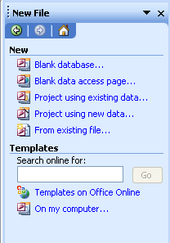
Getting Started MS Access
Start -> Program -> M/S Office -> M/S Access 2003.
File -> New.
New File dialog box appear and then choose Blank database.

Slide 7
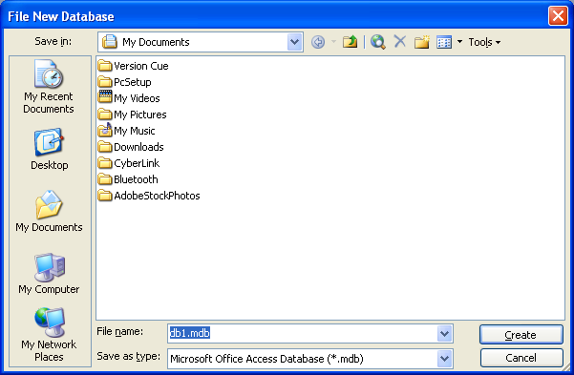
Getting Started MS Access
You must give the database name.
If you forget, Access assign a default name, such as db1, extension is .mdb.
Click Create button to create a database.

Slide 8
Access database files
Using Microsoft Access, you can manage all your information from a single database file. Within the file, you can use:
Tables to store your data.
Queries to find and retrieve just the data you want.
Forms to view, add, and update data in tables.
Reports to analyze or print data in a specific layout.
Data access pages to view, update, or analyze the database's data from the Internet or an intranet.

Slide 9
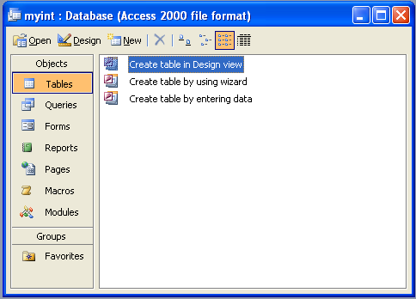
Create A Table in Design View

Slide 10
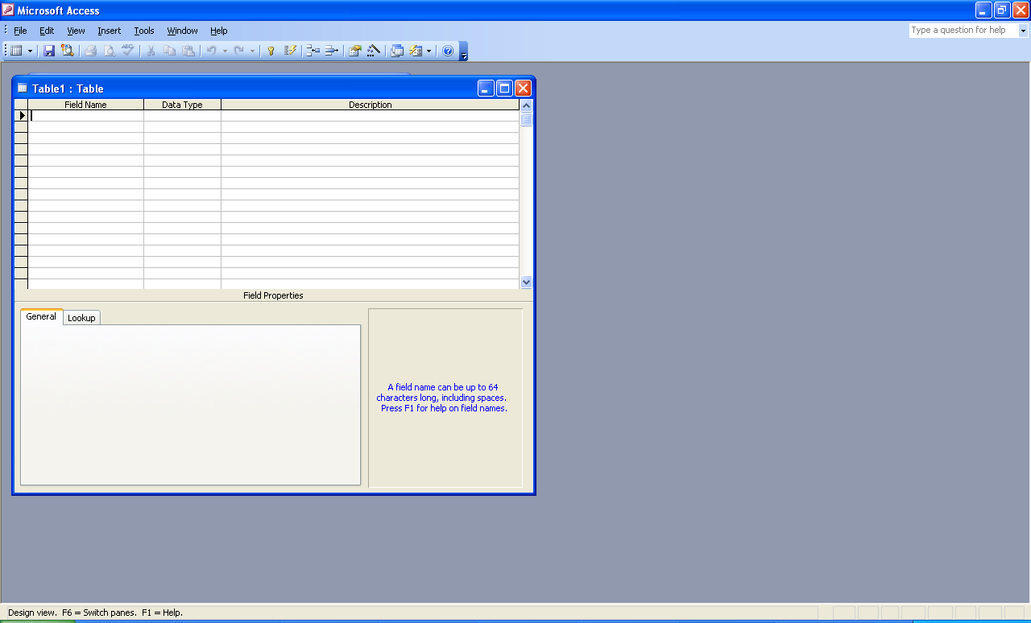
Create A Table in Design View
Click Tables under Objects in the Database window .
Double click Create Design View.

Slide 11
Create A Table in Design View
Define each of the fields in your table.
Click in the Field Name column and type a unique name for the field.
Choose appropriate data type in the Data Type column.
In the Description column, type a description of the information this field.

Slide 12
Data type
Text
Use for text, such as addresses, or for numbers that do not require calculations, such as phone numbers, part numbers, or postal codes.
Stores up to 255 characters. The FieldSize property controls the maximum number of characters that can be entered.
Memo
Use for lengthy text and numbers, such as notes or descriptions.
Stores up to 65,536 characters.
Number
Use for data to be included in mathematical calculations. The FieldSize property defines the specific Number type.
Date/Time
Use for dates and times.
Stores 8 bytes.
Currency
Use for currency values and to prevent rounding off during calculations.
Stores 8 bytes.

Slide 13
Data Type
AutoNumber
Use for unique sequential (incrementing by 1) or random numbers that are automatically inserted when a record is added.
Yes/No
Use for data that can be only one of two possible values, such as Yes/No, True/False, On/Off. Null values are not allowed.
Stores 1 bit.
OLE Object
Use for OLE objects (such as Microsoft Word documents, Microsoft Excel spreadsheets, pictures, sounds, or other binary data) that were created in other programs using the OLE protocol.
Stores up to 1 gigabyte (limited by disk space).
Hyperlink
Use for hyperlinks. Stores up to 64,000 characters.
Lookup Wizard
Use to create a field that allows you to choose a value from another table or from a list of values using a combo box.

Slide 14
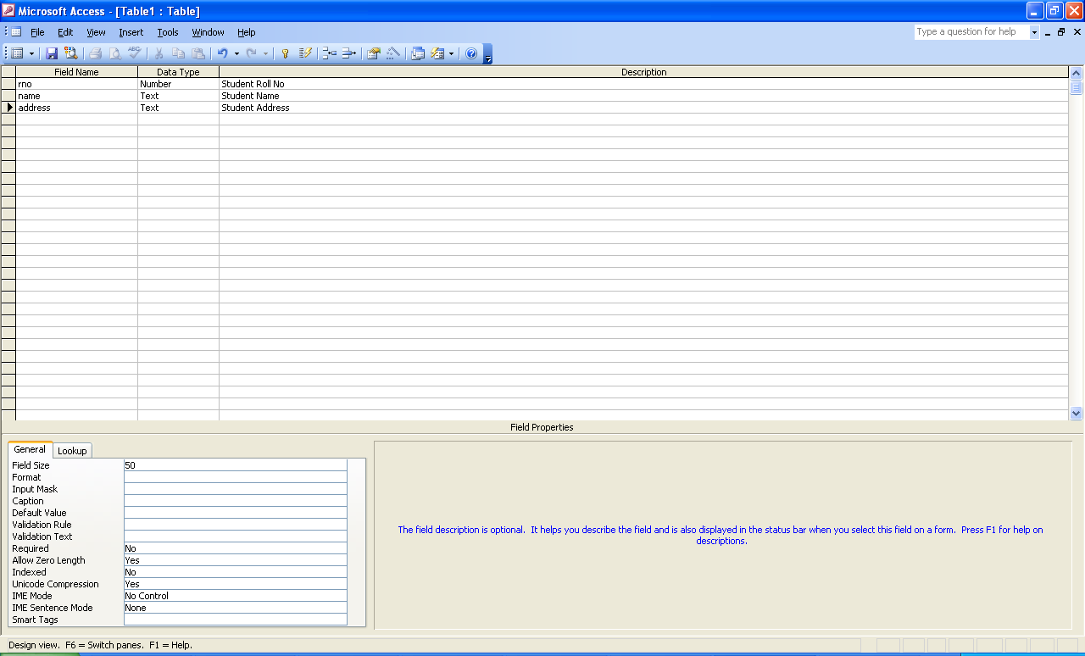
Create A Table in Design View

Slide 15
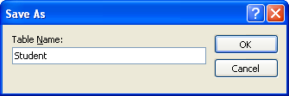
Create A Table in Design View
Fill the field name, then save the table

Slide 16
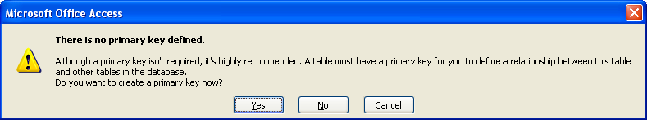
Create A Table in Design View
Define a primary key before saving your table,
If you want to primary key, click Yes.

Slide 17
Change the Field Size
Text fields
You can change the filed size of a text to specify the maximum size of data you can enter into the field.
In the field size, type the maximum number of character you want to accept.
Number fields
Click the field you want to accept only a certain type of number.
Click the type of number you want to accept

Slide 18
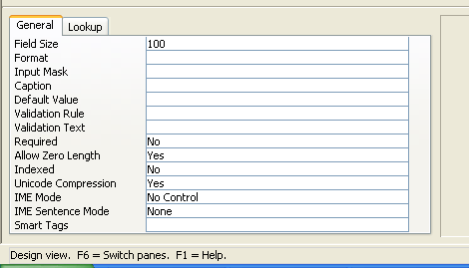
Change the Field Size

Slide 19
Add a Default Value
You can specify a value that you want to appear automatically in a field each time you add a new record.
This saves you from having to type the same data over and over again.
Click the field you want to have a default value.
Type the text or number you want to set as the default value.
Click Save.
Display the table in the datasheet veiw.

Slide 20
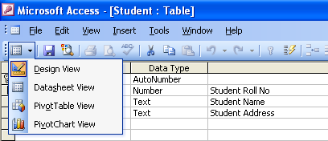
Change The Data Sheet View
Then, change the Datasheet View

Slide 21
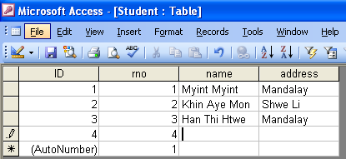
Fill to the data

Slide 22
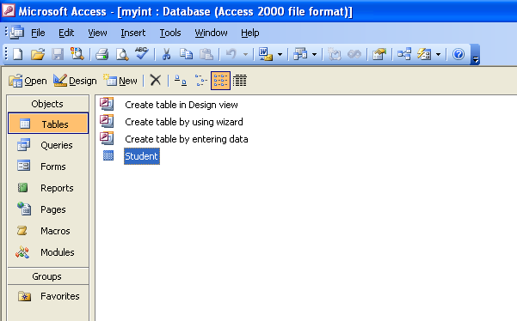
After created one table

Slide 23
Add a Validation Rule
You can add a validation rule to a field to help reduce error when entering data.
A field that uses a validation rule can only accept data that meets certain requirement.
Click the field you want to accept only certain values
Click the area Validation Rule.
Type the validation rule that will limit the data you can enter into the field.
To create the error message you want to appear when you enter incorrect data.
Click the Validation Text and Type the error message you want to appear.

Slide 24
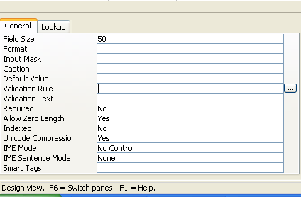
Add a Validation Rule
When you want to add a validation rule,
In the design view, click the field Name you want to add the validation
Click the validation rule

Slide 25
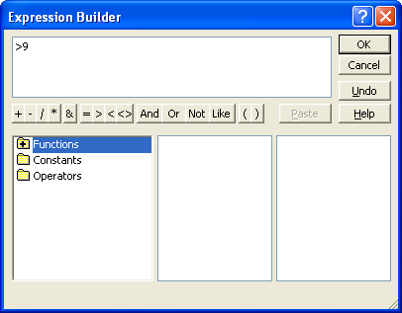
Add a Validation Rule
Type the data in the expression builder, then save the changes.

Slide 26
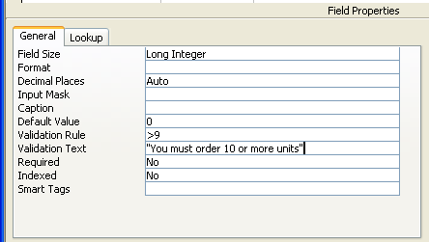
Example

Slide 27
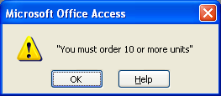
Error Message of validation

Slide 28
add a field to a table in design view
Open the table in Design view.
To insert the field within the table, click in the row below where you want to add the field, and then click Insert Rows on the toolbar.
To add the field to the end of the table, click in the first blank row.
Click in the Field Name column and type a unique name for the field.
In the Data Type column, keep the default (Text); or click in the Data Type column, click the arrow, and select the data type you want.
In the Description column, type a description of the information this field will contain.

Slide 29
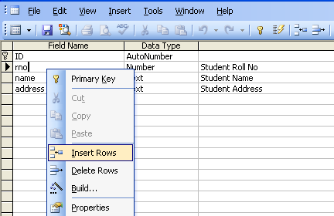
add a field to a table in design view
Right-click, on the desire row, click insert rows.

Slide 30
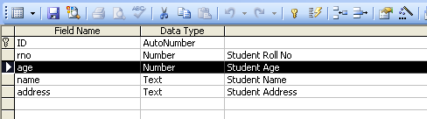
Delete Rows (existing field)
In the design view, select the row, you want to delete.

Slide 31
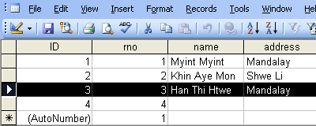
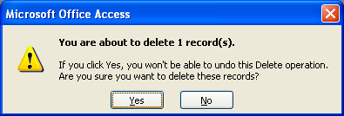
Delete the existing data (record)
Select the data, you want to delete, then press delete on the keyboard.

Slide 32
Rename a field in a table or datasheet
1. Open the table in Design view.
2. Double-click the field name you want to change.
3. Type the new field name.
4. Click Save on the toolbar to save your changes.

Slide 33
Thank you!!!

